Slide 1
Weekly report: Foundations
Week number: 9
Date: 25/11/2025
Supervisor: Prof. Dr.-Ing. Torsten Faber
Group members : Jehad Albaali- Amgad Gerges - Reda Deif
presented by : Amgad Gerges

Slide 2
List of contents
Check punching shear stress
Types of connection between Tower and foundation
Group members: Jehad Albaali- Amgad Gerges - Reda Deif
Foundations team/ Optimus Syria

Slide 3
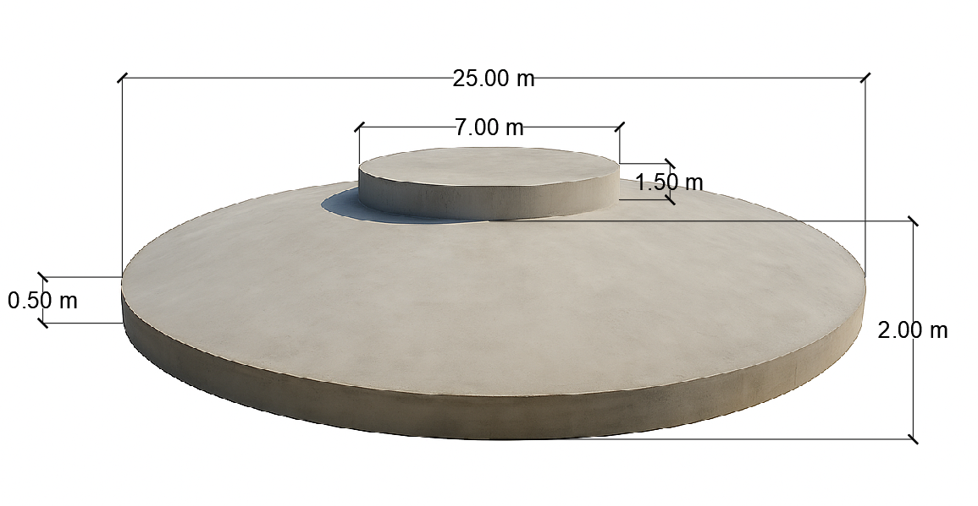
Concrete Dimensions
Diameter of Base Plate (BP) = 25 m
Diameter of Pedestal = 7 m
Height Pedestal = 1.5 m
Height of Middle slab = 2 m
Height of Frustum (HF) = 1.5 m
Height of Edge slab (HE) = 0.5 m
Group members: Jehad Albaali- Amgad Gerges - Reda Deif
Foundations team/ Optimus Syria

Slide 4
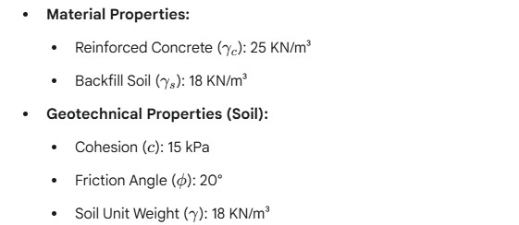
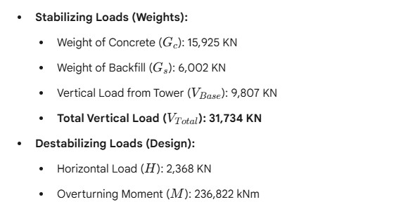
Input data
Group members: Jehad Albaali- Amgad Gerges - Reda Deif
Foundations team/ Optimus Syria

Slide 5
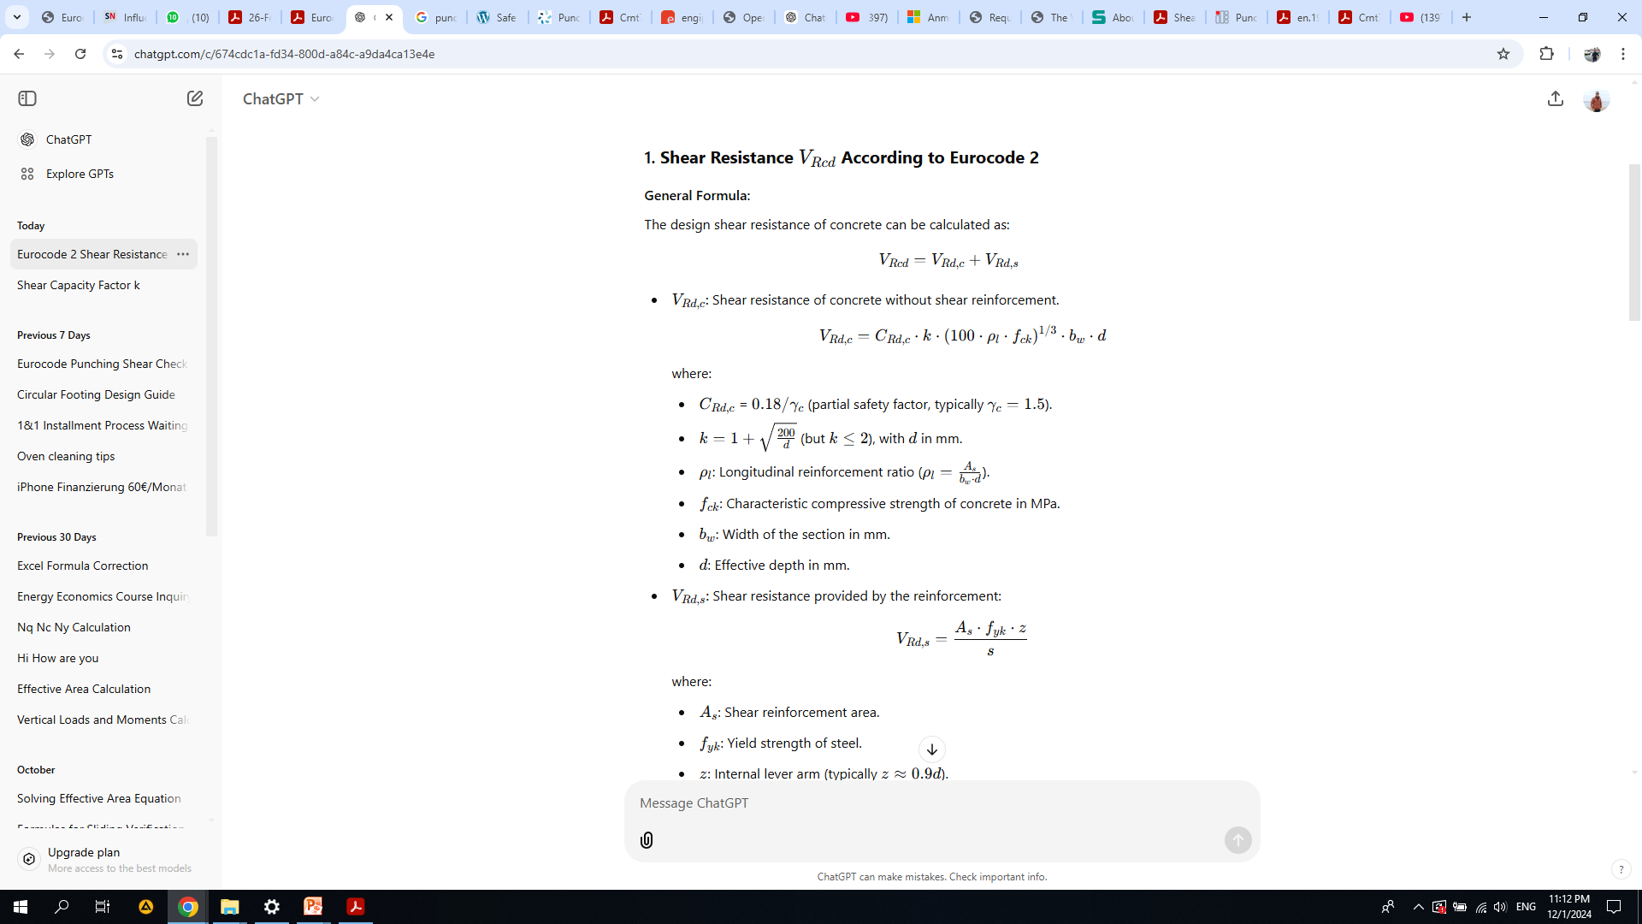
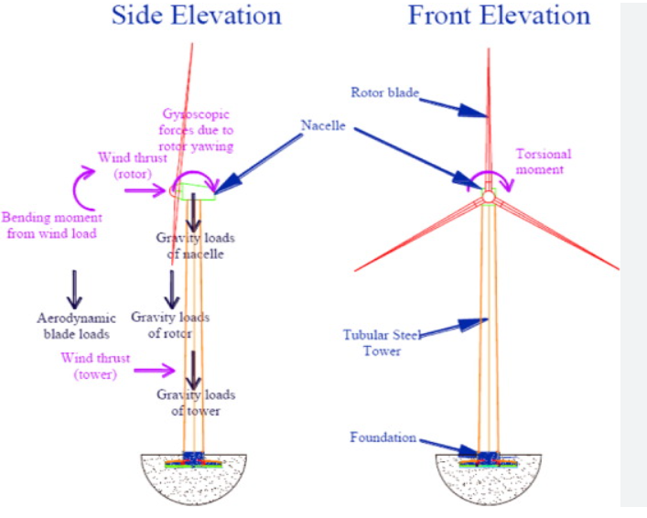
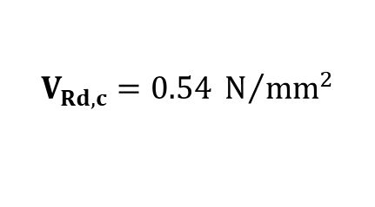
Check punching shear stress
Reference:
EN 1992 – Eurocode 2: Design of Concrete Structures
$$V_{Rd,c}= 0.12∗1.32{\left(100∗0.00182 ∗ 30 \right)}^{\frac{1}{3}}∗1000∗1950$$
$$V_{Rd,c}=0.54 N/{{mm}^{2}}$$
Group members: Jehad Albaali- Amgad Gerges - Reda Deif
Foundations team/ Optimus Syria

Slide 6
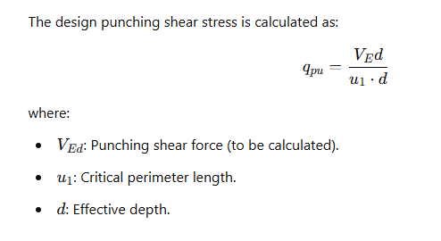
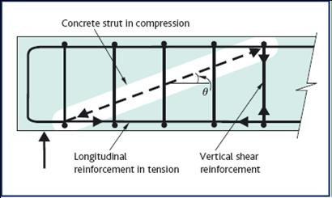


Check punching shear stress
Reference :
Concrete grades according to EC 2 and DIN 1045-1 (2008)
$$q_{pu}=\frac{31,734∗{10}^{3}}{47,123∗1950}=0.34 N/{{mm}^{2}}$$
EN 1992 – Eurocode 2: Design of Concrete Structures
$$q_{pu}<V_{Rd,c} →safe$$
Group members: Jehad Albaali- Amgad Gerges - Reda Deif
Foundations team/ Optimus Syria

Slide 7
Types of connection between Tower and foundation
Anchor cage System
A large group of anchor bolts is connected to two steel rings (upper and lower),These bolts are pre-tensioned to resist tensile forces.
Advantages
Active system: Pre-tensioned bolts directly transfer tensile forces without relying on concrete cracking.
Clear and predictable load path: bolts carry tension, slab reinforcement carries bending.
Easy inspection and maintenance: since bolts and flange are accessible
Simple installation and alignment with tower
Group members: Jehad Albaali- Amgad Gerges - Reda Deif
Foundations team/ Optimus Syria

Slide 8
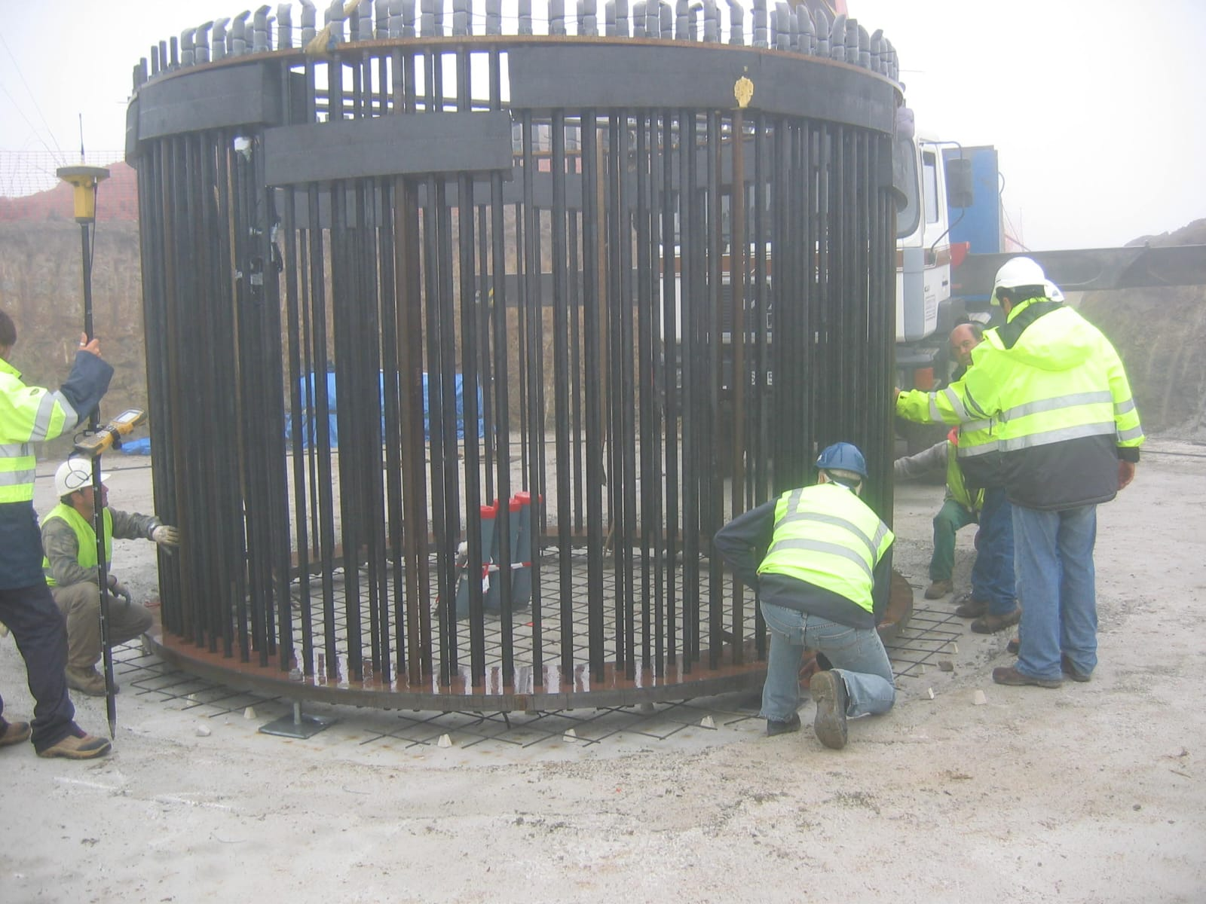
Types of connection between Tower and foundation
Anchor cage System
Disadvantages
Requires perfect bolt alignment and accurate pre-tensioning.
Risk of bolt fatigue or corrosion over time.
More components → more maintenance.
Group members: Jehad Albaali- Amgad Gerges - Reda Deif
Foundations team/ Optimus Syria

Slide 9
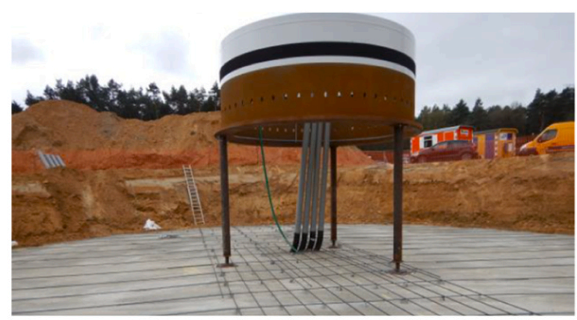
Types of connection between Tower and foundation
Embedded Ring System
A steel ring section with holes for reinforcement is embedded 1.5–2 m into the concrete foundation as part of the tower
Advantages
No anchor bolts → eliminates bolt fatigue issues.
Provides very rigid connection.
Simple external geometry
Disadvantages
Passive system → tensile forces require concrete cracking to activate reinforcement.
Hard to inspect or repair if any defect occurs because the steel is embedded.
Requires very high-quality concrete work around the steel section
Group members: Jehad Albaali- Amgad Gerges - Reda Deif
Foundations team/ Optimus Syria

Slide 10
Time Schedule Planning
Week 1-2: Data Collection & Project Kick-off
Week 3-4: Geotechnical Analysis & Conceptual Design
Week 5-7: Detailed Design & Verification
Week 8-9: Structural Design (Rebar & Shear)
Week 10 : Design connection between Tower and Foundation
11: Final Drawings & Documentation
Week 12: Final Review & Submission
Group members: Jehad Albaali- Amgad Gerges - Reda Deif
Foundations team/ Optimus Syria

Slide 11
Next Tasks
Choose and Design connection between Tower and Foundation
Group members: Jehad Albaali- Amgad Gerges - Reda Deif
Foundations team/ Optimus Syria

